Slide 1

SYLLABUS
MODULE – I: INTRODUCTION
Algorithm: Pseudo code for expressing algorithms; Performance analysis: Space complexity, time complexity; Asymptotic notations: Big O notation, omega notation, theta notation and little o notation, amortized complexity; Divide and Conquer: General method, binary search, quick sort, merge sort, Strassen„s matrix multiplication.
MODULE – II: SEARCHING AND TRAVERSAL TECHNIQUES
Disjoint set operations, union and find algorithms; Efficient non recursive binary tree traversal algorithms, spanning trees; Graph traversals: Breadth first search, depth first search, connected components, biconnected components.
MODULE – III: GREEDY METHOD AND DYNAMIC PROGRAMMING
Greedy method: The general method, job sequencing with deadlines, knapsack problem, minimum cost spanning trees, single source shortest paths.
Dynamic programming: The general method, matrix chain multiplication optimal binary search trees, 0/1 knapsack problem, single source shortest paths, all pairs shortest paths problem, the travelling salesperson problem.

Slide 2
SYLLABUS
MODULE – IV: BACKTRACKING AND BRANCH AND BOUND
Backtracking: The general method, the 8 queens problem, sum of subsets problem, graph coloring, Hamiltonian cycles; Branch and bound: The general method, 0/1 knapsack problem, least cost branch and bound solution, first in first out branch and bound solution, travelling salesperson problem.
MODULE – V: NP-HARD AND NP-COMPLETE PROBLEMS
Basic concepts: Non-deterministic algorithms, the classes NP - Hard and NP, NP Hard problems, clique decision problem, chromatic number decision problem, Cook's theorem.
TEXT BOOKS:
Ellis Horowitz, Satraj Sahni, Sanguthevar Rajasekharan, “Fundamentals of Computer Algorithms”, Universities Press, 2nd
/Edition, 2015.
2. Alfred V. Aho, John E. Hopcroft, Jeffrey D, “The Design And Analysis Of Computer Algorithms”, Pearson India, 1st
Edition, 2013.
REFERENCE BOOKS:
1. Levitin A, “Introduction to the Design and Analysis of Algorithms”, Pearson Education, 3rd Edition, 2012.
2. Goodrich, M. T. R Tamassia, “Algorithm Design Foundations Analysis and Internet Examples”, John Wileyn and Sons,
1st Edition, 2001.
3. Base Sara Allen Vangelder, “Computer Algorithms Introduction to Design and Analysis”, Pearson, 3rd Edition, 1999.

Slide 3
Module - I
Informal Definition:
An Algorithm is any well-defined computational procedure that takes some value or set of values as Input and produces a set of values or some value as output. Thus algorithm is a sequence of computational steps that transforms the I/P into the O/P.
Algorithm Definition : An Algorithm is a finite set of instructions that, if followed, accomplishes a particular task.
In addition, all algorithms should satisfy the following criteria.
Properties ( or ) Characterstics of Algorithm
An algorithm should posses following properties (or) characterstics –
: Input : The algorithm should produce zero or more number of quantities, as an input.
: Output : The algorithm should produce at least one quantity, as an output.
: Definiteness : Each instruction is clear and unambiguous.

Slide 4
Module - I
4. Finiteness : If we trace out the instructions of an algorithm, then for all cases, the algorithm terminates after a finite number of steps.
5. Effectiveness : Every step of algorithm should be effective. Every operation can be roughly by pen and paper. So tracing of each step of algorithm should be done
Issues ( or ) Design of Algorithm
There are various steps for algorithm design.
1 : Understanding the problem. 2 : Decision making.
3 : Specification of algorithm. 4 : Verification of algorithm.
5 : Analysis of algorithm. 6 : Implementation or coding of algorithm.
7 : Testing a program.
1 : Understanding the problem: The first thing you need to do before designing an algorithm is to understand problem completely. This is a crucial phase, so we should be very careful. If we did any mistake in this step the entire algorithm becomes wrong. Ask questions if you have doubts about the problem and think about special cases.

Slide 5
Design of Algorithm
2 : Decision Making : After finding the required input set for the given problem we have
to analyze the input and need to decide certain issues such as
A ) Capability of computational devices : It is necessary to know the computational capabilities of devices on which the algorithm will be running. Globally we can classify an algorithm from execution point of view as sequential algorithm and parallel algorithm.
Sequential algorithm : specifically runs on the machine in which the instruction are executed one after
another. Such machine is called as Random Acess Machine (RAM ).
Parallel algorithm : are run on the machine in which the instruction are executed in parallel.
B ) Choice for either exact or approximate problem solving method : The next important decision is to decide whether the problem is to be solved exactly or approximately. If the problem needs to be solved correctly then we need exact algorithm. Otherwise if the problem is so complex that we won’t get the exact solution then we need to choose approximation algorithm.

Slide 6
Design of Algorithm
C ) Algorithm Design Techniques : In this we will use different design techniques.
Different types of algorithm design techniques :
1 : Brute – force.
: Divide and Conquer.
: Dynamic programming.
4 : Greedy technique.
: Back tracking.
: Branch and Bound
3 : Specification of algorithm : There are various ways we can specify an algorithm.
1 : Natural language. 2 : Pseudo code. 3 : Flowchart.
1 : Natural language : It is very simple to specify an algorithm using natural language. But many times specification of algorithm by using natural language is not clear, and there by we get brief specification.

Slide 7
Design of Algorithm
Ex : Write an algorithm to perform addition of two numbers.
Step 1 : Read the first number say a.
Step 2 : Read the second number say b.
Step 3 : Add the two numbers and store the result in a variable c.
Step 4 : Display the result.
Such a specification creates difficulty while actually implementing it. Hence many programmers prefer to have specification of alogorithm by means of pseudo code.
pseudo code : pseudo code is nothing but a combination of natural language and programming language constructs. A pseudo code is usually more precise than a natural language.

Slide 8
Design of Algorithm
Ex : Write an algorithm to perform addition of two numbers.
Algorithm sum(a,b)
{
// Problem description : This algorithm performs addition of two integers.
// Input : Two integers a and b.
// Output : addition of two integers.
c <- a + b; write ( c );
}
This specification is more useful from implementation point of view.
3: Flowchart : flowchart is a graphical representation of an algorithm

Slide 9
 | Description | Symbols
1 | Flowlines : These are the left to right or to to bottom lines connection symbols. These lines shows the flow of control through the program.
2 | Terminal Symbol : The oval shaped symbol always begins and ends the flowchart. Every flow chart starting and ending symbol is terminal symbol.
3 | Input / Output symbol : The parallelogram is used for both input (Read) and Output (Write) is called I/O symbol. This symbol is used to denote any function of an I/O device in the program.
4 | Process Symbol : The rectangle symbol is called process symbol. It is used for calculations and initialization of memory locations
5 | Decision symbol : The diamond shaped symbol is called decision symbol. This box is used for decision making. There will be always two exists from a decision symbol one is labeled YES and other labeled NO.
6 | Connectors : The connector symbol is represented by a circle. Whenever a complex flowchart is morethan one page, in such a situation, the connector symbols are used to connect the flowchart.
9

Slide 10
Example :
Start
Input a and b values
c = a + b
Display the value of c
Stop
: Verification of algorithm : Verification of algorithm means checking correctness of an algorithm. After specifying an algorithm we go for checkeing its correctness. We normally check whether the algorithm gives correct output in finite amount of time for a valid set of input. The proof of correctness of an algorithm can be complex sometimes. A common method of proving the correctness of an algorithm is by using mathematical induction. But to show that an algorithm works incorrectly we have to show that at least for one instance of valid input the algorithm gives wrong result.
: Analysis of algorithm : Analyzing an algorithm we should consider following factors.
1 : Time Complexity. 2 : Space Complexity. 3 : Simplicity. 4 : Generality. 5 : Range of input.
10

Slide 11
Design of Algorithm
1. Time Complexity : The Time Complexity can be defined as amount of computer time required by an algorithm to run to completion. By computing time complexity we can analyze whether an algorithm requires slow or fast.
2. Space Complexity: The Space Complexity can be defined as amount of space required by an algorithm to run to completion. By computing space complexity we can analyze whether an algorithm requires more or less space.
3. Simplicity : Simplicity of an algorithm means generating sequence of instructions which are easy to understand. This is an important characterstic of an algorithm. because simple algorithms can be understood quickly and one can then write simpler programes for such algorithms.
4. Generality : Generality shows that sometimes it becomes easier to design an algorithm in more general way rather than designing it for particular set of input. Hence we should write general algorithms always.
5. Range of input : Range of inputs comes in picture when we execute an algorithm. The design of algorithm should be handle the range of input which is the most natural to corresponding problem.
Analysis of algorithm means checking the characteristics such as : Time complexity, Space complexity, simplicity, generality and range of input. If these factors are not satisfactory then we must redesign the algorithm.

Slide 12
Design of Algorithm
6. Implementation or coding of algorithm : The implementation of an algorithm is done by suitable programming language. For example : if an algorithm consists of object and related methods then it will be better to implement such algorithm using some object-oriented programming language like C++ and JAVA. While writing a program for given algorithm it is essential to write an optimized code. This will reduce the burden on computer.
7. Testing a program : Testing a program is an activity carried out to expose as many errors as possible and to correct them. There are two phases for testing a program.
: Debugging.
: Profiling.
1. Debugging : Debugging is a technique in which a sample set of data is tested to see whether faulty results occur or not. If any faulty result occurs then those results are corrected.
But in debugging technique only presence of error is pointed out. Any hidden error can not be identified. Thus in debugging we cannot verify correctness of output on sample data. Hence profiling concept is introduced.
2. Profiling : Profiling is the process of executing a correct program on a sample set of data. Then the time and space required by the program to execute is measured.

Slide 13
PSEUDO CODE FOR EXPRESSING ALGORITHM : Hypothetical language is used to define
the algorithm is called pseudo code. It is not a programming language because it is not having any compiler. It is used to represent the algorithm.
The following rules are involved to represent the algorithm by using pseudo code
1 : Algorithm is a procedure which consisting of heading and body. The heading consisting of keyword Algorithm and name of the algorithm and parameter list.
Syntax : Algorithm name ( p1, p2, ..............., pn)
This keyword should be written first
write parameters ( if any ) name of an Algorithm
: The heading section we should write following things :
// Problem Description :
// Input :
// Output :
: The body of an algorithm is written, in which various programming constructs like if, for, while or some assignment statements may be written.
: The beginning and end of block should be indicaed by { and } respectively. The compound statements should be enclosed within { and } brackets.
: The delimiters ; are used at the end of each statement.
: Single line comments are written using // as beginning of comment.
: The identifier should begin by letter and not by digit. An identifier can be a combination of
alphanumeric string.
It is not necessary to write data types explicitly for identifiers. It will be
represented by the context itself. Basic data types used are integer, float, char, Boolean and so on. The pointer type is also used to point memory location.
: The input and output can be done by read and write
Ex : write (“This message will be displayed on console”); read(val);
13

Slide 14
PSEUDO CODE FOR EXPRESSING ALGORITHM
PSEUDO CODE FOR EXPRESSING ALGORITHM : Hypothetical language is used to define the algorithm is called pseudo code. It is not a programming language because it is not having any compiler. It is used to represent the algorithm.
The following rules are involved to represent the algorithm by using pseudo code
1 . Algorithm is a procedure which consisting of heading and body. The heading consisting of keyword Algorithm and name of the algorithm and parameter list.
Syntax : Algorithm name ( p1, p2, ..............., pn)
2. The heading section we should write following things :
// Problem Description :
// Input :
// Output :
3. The body of an algorithm is written, in which various programming constructs like if, for, while or some assignment statements may be written.

Slide 15
PSEUDO CODE FOR EXPRESSING ALGORITHM
4. The beginning and end of block should be indicated by { and } respectively. The compound statements should be enclosed within { and } brackets.
5. The delimiters ; are used at the end of each statement.
6. Single line comments are written using // as beginning of comment.
7. The identifier should begin by letter and not by digit. An identifier can be a combination of alphanumeric string. It is not necessary to write data types explicitly for identifiers. It will be represented by the context itself. Basic data types used are integer, float, char, Boolean and so on. The pointer type is also used to point memory location.
8. The input and output can be done by read and write
Ex : write (“This message will be displayed on console”);
read(val);

Slide 16
PSEUDO CODE FOR EXPRESSING ALGORITHM
9. Boolean operators such as True or False.
Logical operators such as and, or, not. Relational operators such as <, <=, >, >=, ==, #.
10. Assignment of values to variables is done using the assignment statement.
Syntax : variable : = expression; Ex : a := 10;
11. The array indices are stored with in square brackets ‘[‘ ‘]’. The index of array usually start at zero. The multidimensional arrays can also be used in algorithm.
12. The conditional statements such as if-then or if-then-else are written in following form :
Syntax : if( condition ) then (statement 1)
if( condition ) then (statement 2 )else (statement 3)
if the if-then statement is of compound type then { and } should be used for enclosing block.

Slide 17
PSEUDO CODE FOR EXPRESSING ALGORITHM
13. while statement can be written as :
while(condition) do
{
statement 1
statement 2
:
:
statement n
}
While the condition is true the block gets executed otherwise statement after the block will be executed.
14. for loop can be written as :
for variable ß value1 to value n step step size do
{
statement 1;
statement 2;
:
:
statement n;
}

Slide 18
PSEUDO CODE FOR EXPRESSING ALGORITHM
Here value1 is initialization condition and value n is a terminating condition.
Sometime a keyword step is used to denote increment or decrement the value of variable.
Ex : for iß 1 to n step 1
{
Write(i);
}
Here variable i is incremented by 1 at each iteration.
15. The repeat – until statement can be written as :
Repeat
{
statement 1;
statement 2;
:
:
statement n;
}
until(condition)

Slide 19
PSEUDO CODE FOR EXPRESSING ALGORITHM
16. The break statement is used to exit from inner loop. The return statement is used to return control from one point to another. Generally used while exiting from function.
17. Compound data types can be formed with records. Here is an example, Node. Record
{
data type – 1 data-1;
.
.
.
data type – n data – n; node * link;
}
Here link is a pointer to the record type node. Individual data items of a record can be accessed with
à and period.
Note that statements in an algorithm executes in sequential order i.e, in the same order as they appear-one after the other.

Slide 20
PSEUDO CODE FOR EXPRESSING ALGORITHM
Ex: write an algorithm to check whether the given number is even or odd
Algorithm Even_odd (n)
{
if ( n % 2 == 0) then
{
printf( “ the given number is even”);
}
else
{
printf( “ the given number is odd”);
}
}

Slide 21
PSEUDO CODE FOR EXPRESSING ALGORITHM
Ex: Write an algorithm to find sum of n numbers
Algorithm sum_num (n)
{
sum: = 0 ;
for i = 1 to n step 1 do
{
sum:= sum+i;
}
return sum;
}

Slide 22
PSEUDO CODE FOR EXPRESSING ALGORITHM
Ex: Write an algorithm to find reverse of a given number
Algorithm rev_num(n)
{
reverse := 0;
while ( n ! = 0)
{
reverse := reversex10;
reverse := reverse + n %10;
n :=n/10;
}
return reverse;
}

Slide 23
PERFORMANCE ANALYSIS
Performance Analysis refers to the task of determining the computing time and storage space requirements of an algorithm. It is also known as performance analysis.
The main purpose of algorithm analysis is to design most efficient algorithms. The efficiency of the algorithm mainly depends on two factors
1 : Space Complexity 2 : Time Complexity
1 : Space Complexity : The Space Complexity can be defined as amount of space required by an algorithm to run to completion. By computing space complexity we can analysis the algorithm requires less or more space.
The space needed by an algorithm consists of the following components.
1. The fixed part that is independent of the characteristics ( example number size ) of the input and outputs. This part includes the instruction space, space for simple variable and fixed size component variables, space for constants etc..

Slide 24
Space complexity
2. A variable part, that consists of the space needed by component variable whose size is dependent on the particular problem instance at run time being solved, the space needed by referenced variables and the recursion stack space.
The space complexity requirement S(p) can be given as : S(p) = C + Sp
Where C is a constant i.e, fixed part. It denotes amount of space required for inputs, outputs, variables and instructions. And Sp is a instance characteristics. This is a variable part amount of space required for problem is depends on particular problem instance.
Consider the examples of algorithms to compute the space complexity
Ex 1 : Algorithm add(a,b,c)
{
// Problem Description : This algorithm computes the addition of 3 numbers
// Input : a, b and c are of floting type.
// Output : The addition is returned.
return a+b+c;
}

Slide 25

Space complexity
The space requirement for algorithm S(p) = C
If we assume that a, b and c occupy one word size then total size comes to be 3.
Ex: Algorithm sum(x , n)
{
total := 0;
for i$←1 to n do$
total : = total + x[i];
}
Here c = 3 for x ,n , total
Variable part = x[i]
S(P) = 3 + n

Slide 26

Space complexity
Ex: sum of two matrices
Algorithm Add(A, B, n)
{
for ( i $=$0; i<n; i++)
{
for ( j =0; i<n; j ++)
{
C[ i, j ]= A[ i, j ] + B[ i, j ];
}
}
}
Space complexity :
A (two dimensional array ) = $n^{2}$
B (two dimensional array ) = $n^{2}$
C (two dimensional array ) = $n^{2}$
n , i ,j = 3
Space complexity = 3 $n^{2}$+3

Slide 27
Time Complexity
2 : Time Complexity : The Time Complexity can be defined as amount of computer time required by an algorithm to run to completion.
They are two types of computing time.
1. compile time. 2. run time.
For calculating the time complexity, only run time is considered.
It is difficult to compute the time complexity in terms of physically clocked time. Because runtime depends on many factors such as system load, number of other programs running and processor speed.
For avoiding this, we are using frequency count is basically a count denoting number of times of execution of statement.
The method to determine the step count of an algorithm is to build a table in which we list the total number of steps contributes by each statement .

Slide 28
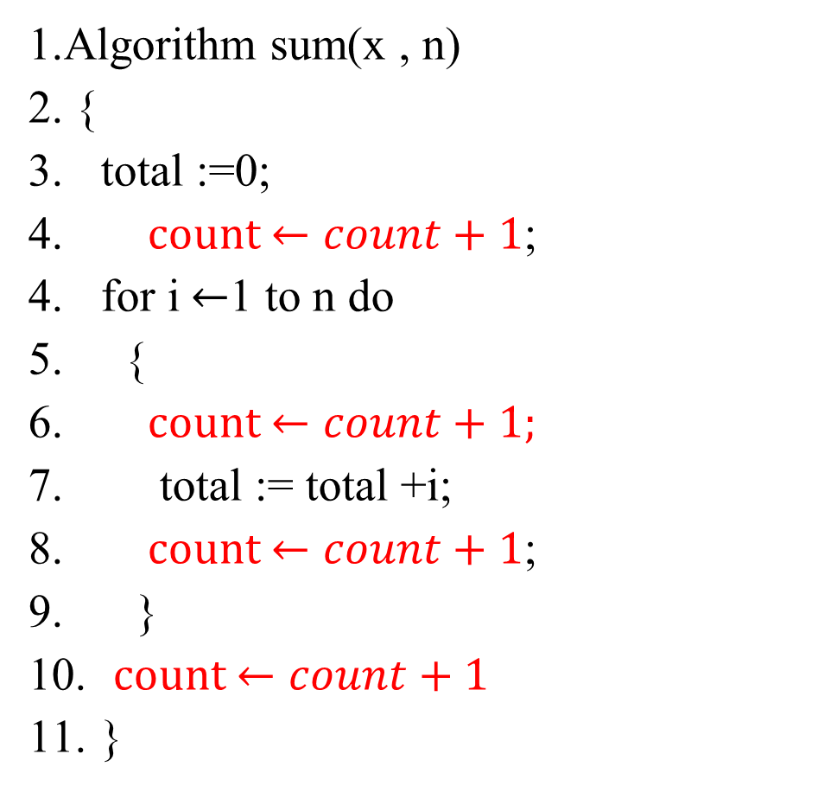

Time Complexity
1.Algorithm sum(x , n)
2. {
3. total :=0;
for i $←$1 to n do
{
total := total + i;
}
}
1.Algorithm sum(x , n)
2. {
total :=0;
count $←count+1$;
for i $←$1 to n do
{
count $←count+1;$
total := total +i;
count $←count+1$;
}
count $←count+1$
}

Slide 29
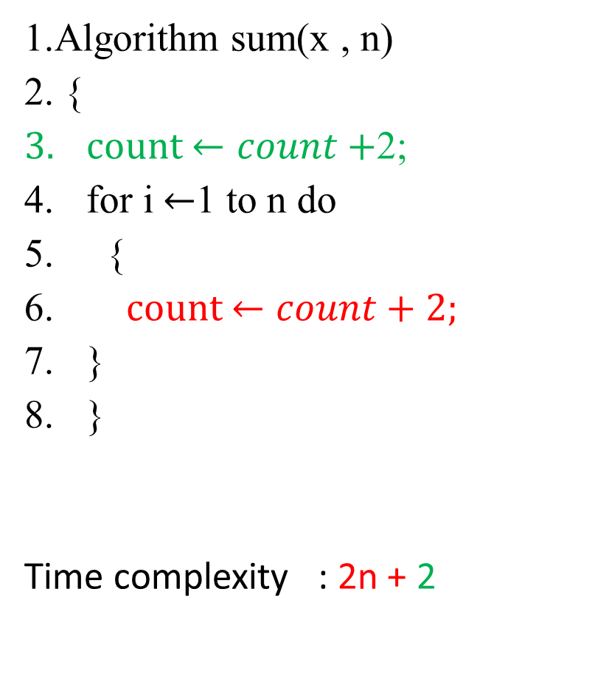
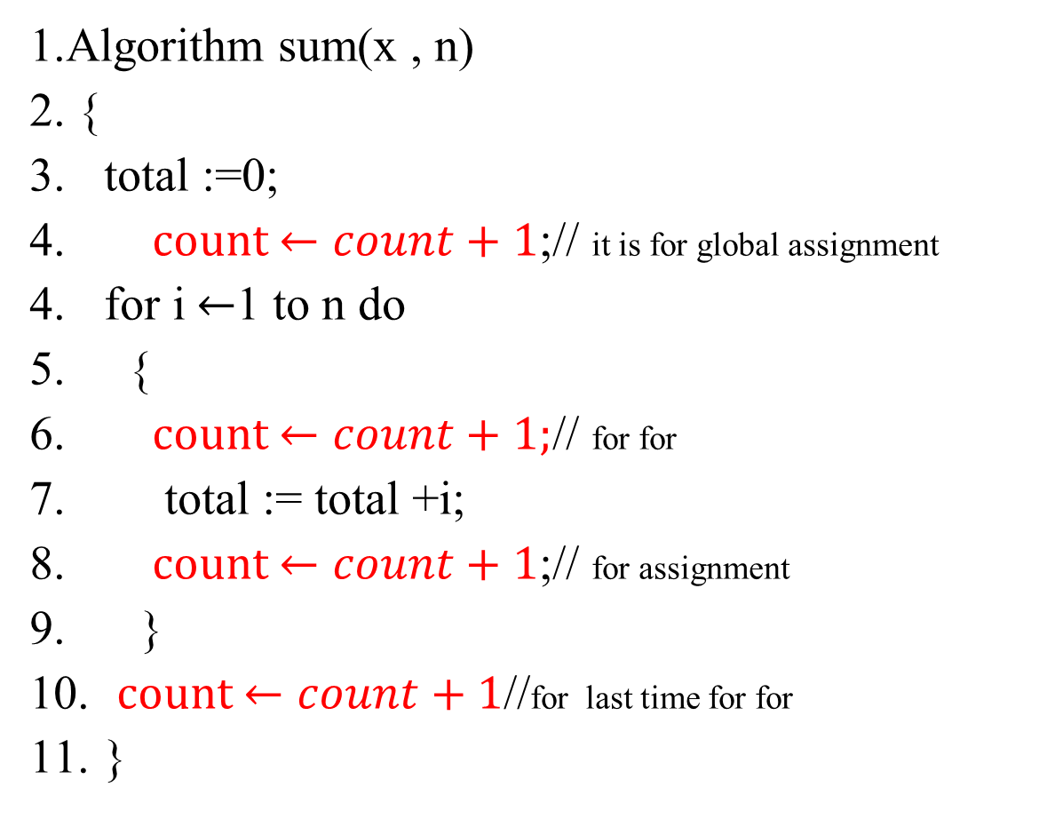
Time Complexity
1.Algorithm sum(x , n)
2. {
total :=0;
count $←count+1$;// it is for global assignment
for i $←$1 to n do
{
count $←count+1;$// for for
total := total +i;
count $←count+1$;// for assignment
}
count $←count+1$//for last time for for
}
1.Algorithm sum(x , n)
2. {
count $←count+$2;
for i $←$1 to n do
{
count $←count+2;$
}
}
Time complexity : 2n + 2

Slide 30
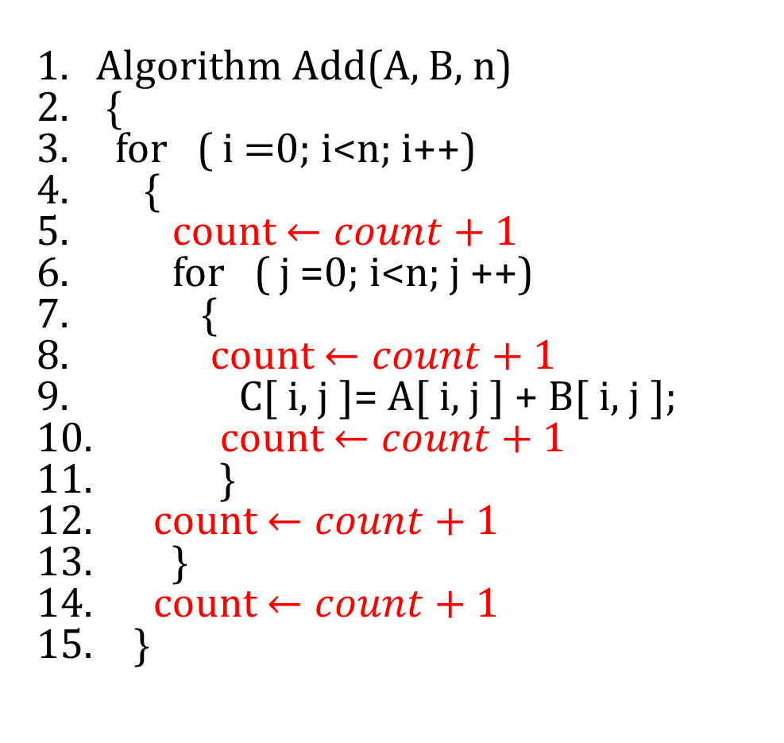
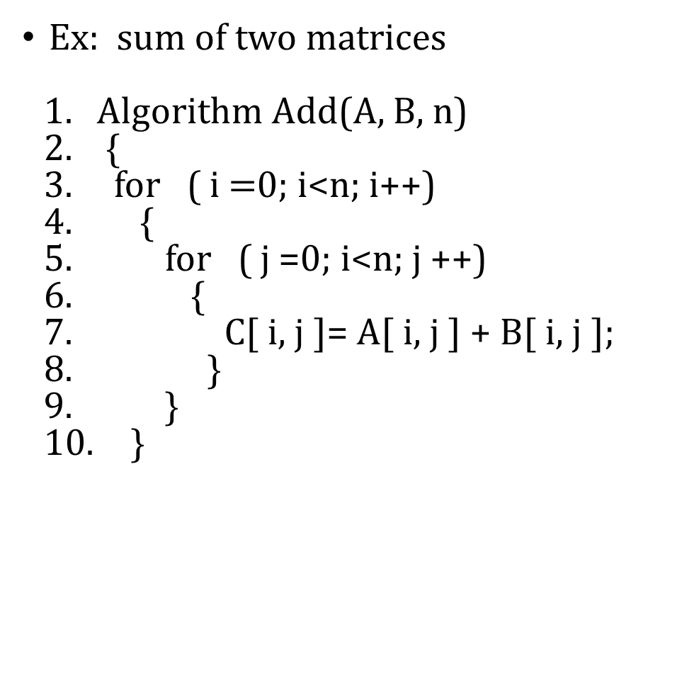
Time complexity
Ex: sum of two matrices
Algorithm Add(A, B, n)
{
for ( i $=$0; i<n; i++)
{
for ( j =0; i<n; j ++)
{
C[ i, j ]= A[ i, j ] + B[ i, j ];
}
}
}
Algorithm Add(A, B, n)
{
for ( i $=$0; i<n; i++)
{
count $←count+1$
for ( j =0; i<n; j ++)
{
count $←count+1$
C[ i, j ]= A[ i, j ] + B[ i, j ];
count $←count+1$
}
count $←count+1$
}
count $←count+1$
}

Slide 31
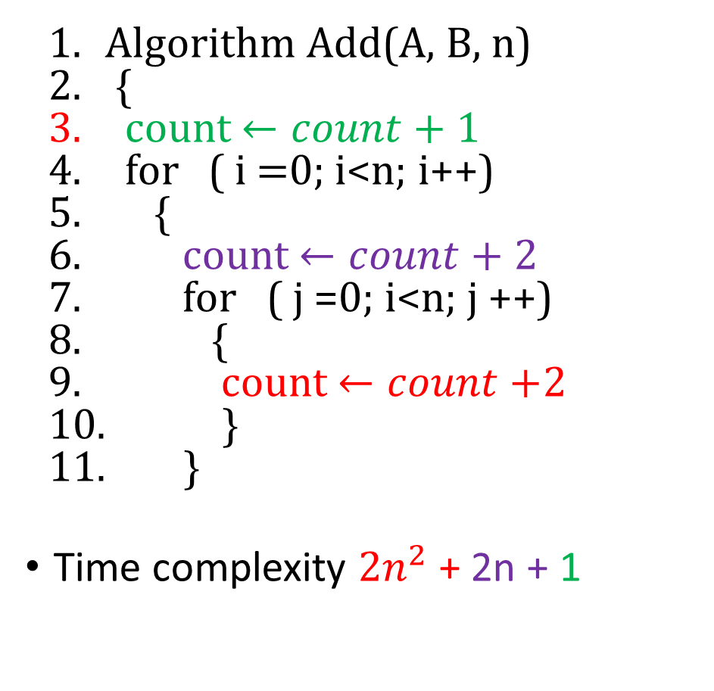
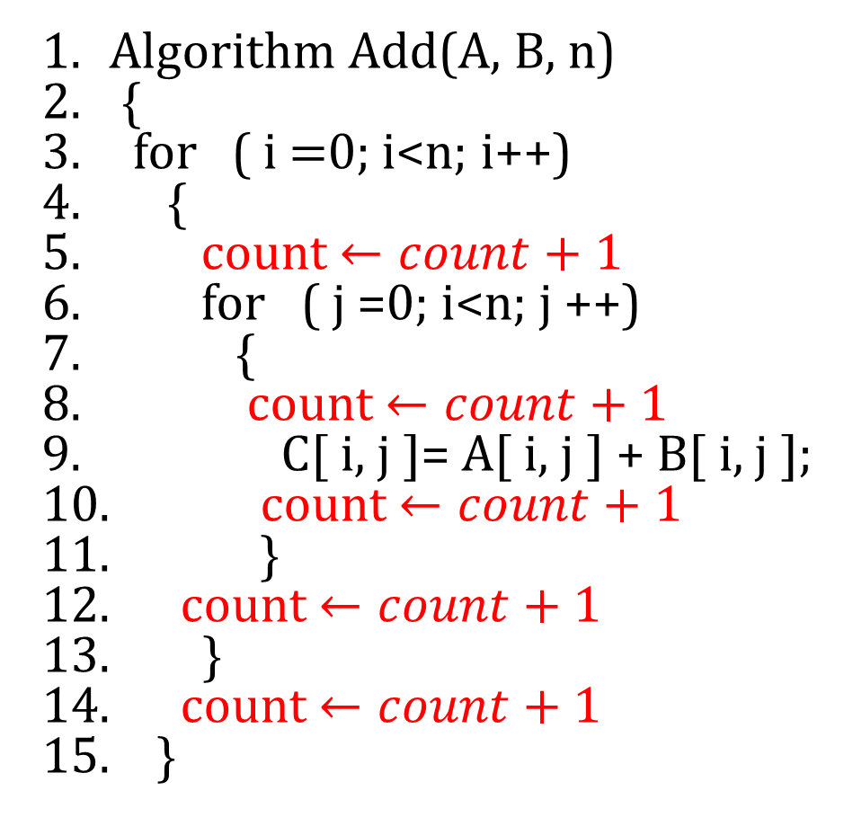
Time Complexity
Algorithm Add(A, B, n)
{
for ( i $=$0; i<n; i++)
{
count $←count+$ 1
for ( j =0; i<n; j ++)
{
count $←count+1$
C[ i, j ]= A[ i, j ] + B[ i, j ];
count $←count+1$
}
count $←count+1$
}
count $←count+1$
}
Algorithm Add(A, B, n)
{
count $←count+1$
for ( i $=$0; i<n; i++)
{
count $←count+$ 2
for ( j =0; i<n; j ++)
{
count $←count+$2
}
}
Time complexity ${2n}^{2}$ + 2n + 1

Slide 32
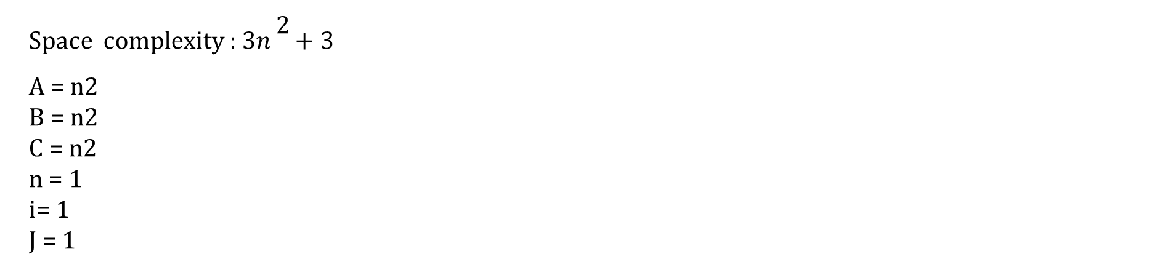
Time Complexity
2
Space complexity : 3$n^{}+3$
A = n2
B = n2
C = n2
n = 1
i= 1
J = 1

Slide 33
Time complexity
Statement | S / E | Frequency | Total Steps
1 Algorithm Sum( A, n) | 0 | - | 0
2. { | 0 | - | 0
3. S = 0.0 ; | 1 | 1 | 1
4. for i = 1 to n do | 1 | N + 1 | N + 1
5. S = S + A{i] ; | 1 | N | N
6. return S ; | 1 | 1 | 1
7. } | 0 | - | 0
Total |  |  | 2N + 3

Slide 34
Time complexity
Statement | S / E | Frequency | Total Steps
1 Algorithm rev_num(n) | 0 | - | 0
2. { | 0 | - | 0
3. reverse := 0; | 1 | 1 | 1
4. while ( n ! = 0) | 1 | n + 1 | n + 1
5. { | 0 | 0 | 0
reverse := reversex10; | 1 | n | n
7. reverse := reverse + n %10; | 1 | n | n
8. n :=n/10; | 1 | n | n
} | 0 | 0 | 0
10. return reverse; | 1 | 1 | 1
11 . } | 0 | 0 | 0
Total |  |  | 4n + 3

Slide 35
Time complexity
Algorithm | Time Complexity | Space Complexity
1.Algorithm fibonacci(n) 2.{ 3. a := 0; --------------------------------- 4. b := 1; ----------------------------------- 5. write a, b; ---------------------------- 6. c := a + b;------------------------------------- 7. while (c<=n) do----------------------------- 8. { 9. write c;-------------------------------------- 10. a := b;----------------------------------------- 11. b := c;---------------------------------------- 12. c := a + b;------------------------------------ 13. } 14. } | 1 1 1 1 n+1 n n n n | a - - 1 b - - 1 c - 1 k - - 1
Total | 5n +4 | S(P) = 4 + 0 = 4

Slide 36
Time complexity
Algorithm | Time Complexity | Space Complexity
1. Algorithm matmul(a,b,c,n) 2. { 3. for i := 1 to n do --------------------- 4. for j := 1 to n do ----------------------- 5. c[i,j] := 0; ----------------------------------- 6. for k:= 1 to n do ----------------------------- 7. c[i,j] := c[i,j] + (a[i,k] * b[k,j]) ---------- 8. return c[i,j]; --------------------------------------- 9. } | n + 1 n(n+1) n² n²(n+1) n³ 1 | i ---- 1 j ---- 1 k --- 1 n ----1 a - - n² b - - n² c - - n²
Total | 2n³+3n²+2n+2 | S(P) = 4 + 3n²

Slide 37
Time complexity
Algorithm | Time Complexity | Space Complexity
1. Algorithm armstrong(n) 2. { 3. m:=n; ------------------------------------ 4. sum := 0; ------------------------------------ 5. while(n>0) do ------------------------------------ 6. { 7. n := n / 10; ------------------------------ 8. k := n % 10; ------------------------- 9. sum := sum + (k * k* k); ------------------- 10. } if(m = sum)----------------------------------------- 12. write “Given number is Armstrong”;---------- 13. else 14. write “Given number is Not Armstrong”;---- 15. } | 1 1 n + 1 n n n 1 1 0 | m - - 1 n - - 1 sum - 1 k - - 1
Total | 4n + 5 | S(P) = 4 + 0 = 4

Slide 38
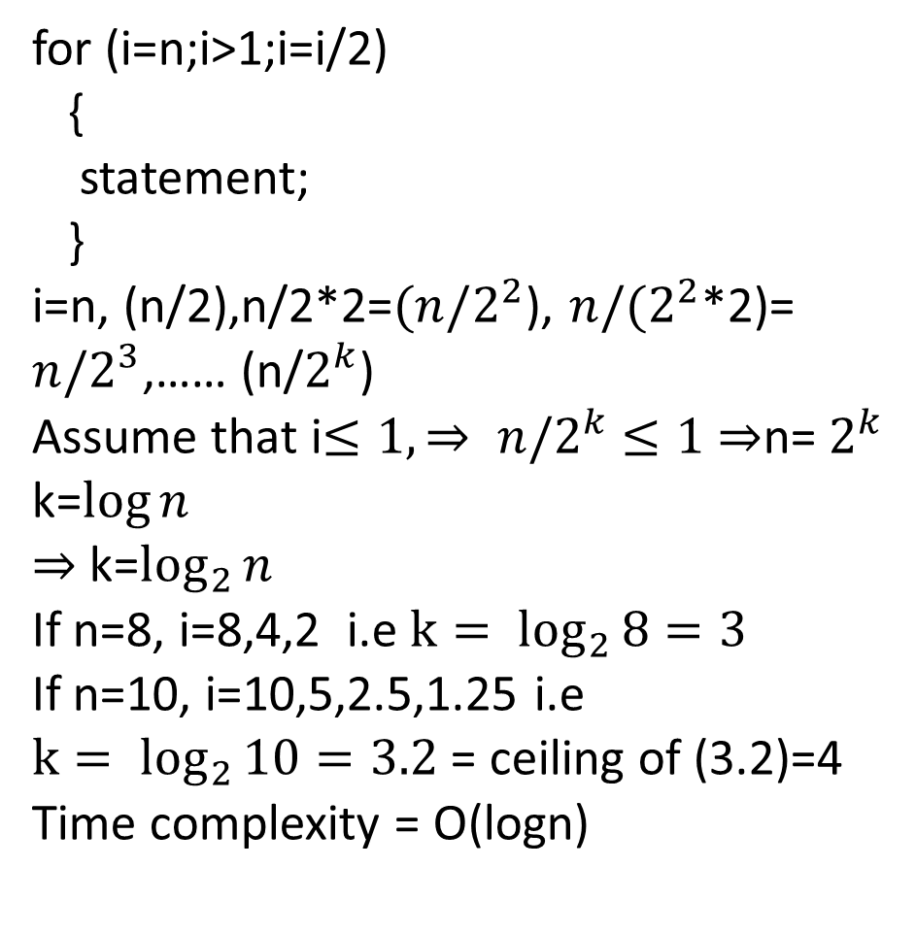
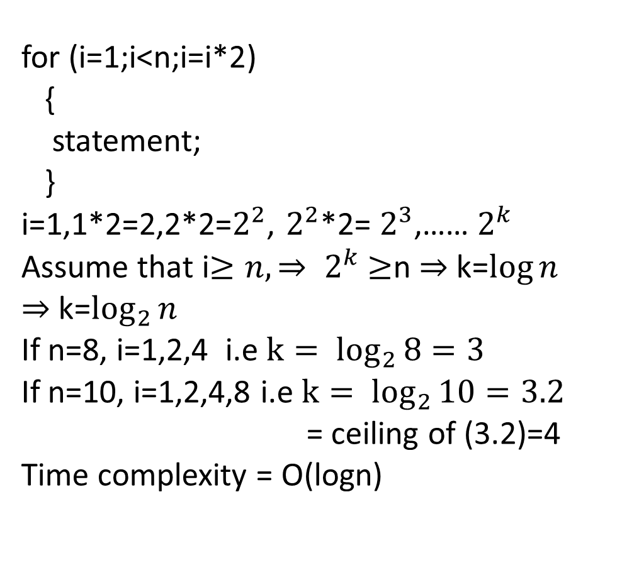
Time Complexity
for (i=1;i<n;i=i*2)
{
statement;
}
i=1,1*2=2,2*2=$2^{2}$, $2^{2}$*2= $2^{3}$,…… $2^{k}$
Assume that i$≥n, ⇒ 2^{k}$ $≥$n $⇒$ k=$\log{n}$
$⇒$k=$\log_{2}{n}$
If n=8, i=1,2,4 i.e ${k= log}_{2}{8=3}$
If n=10, i=1,2,4,8 i.e ${k= log}_{2}{10=3.2}$
= ceiling of (3.2)=4
Time complexity = O(logn)
for (i=n;i>1;i=i/2)
{
statement;
}
i=n, (n/2),n/2*2=${(n/2}^{2}$), ${n/(2}^{2}$*2)=
${n/2}^{3}$,…… (n/$2^{k}$)
Assume that i$≤1, ⇒ {n/2}^{k}$ $≤1$ $⇒$n= $2^{k}$
k=$\log{n}$
$⇒$k=$\log_{2}{n}$
If n=8, i=8,4,2 i.e ${k= log}_{2}{8=3}$
If n=10, i=10,5,2.5,1.25 i.e
${k= log}_{2}{10=3.2}$ = ceiling of (3.2)=4
Time complexity = O(logn)

Slide 39
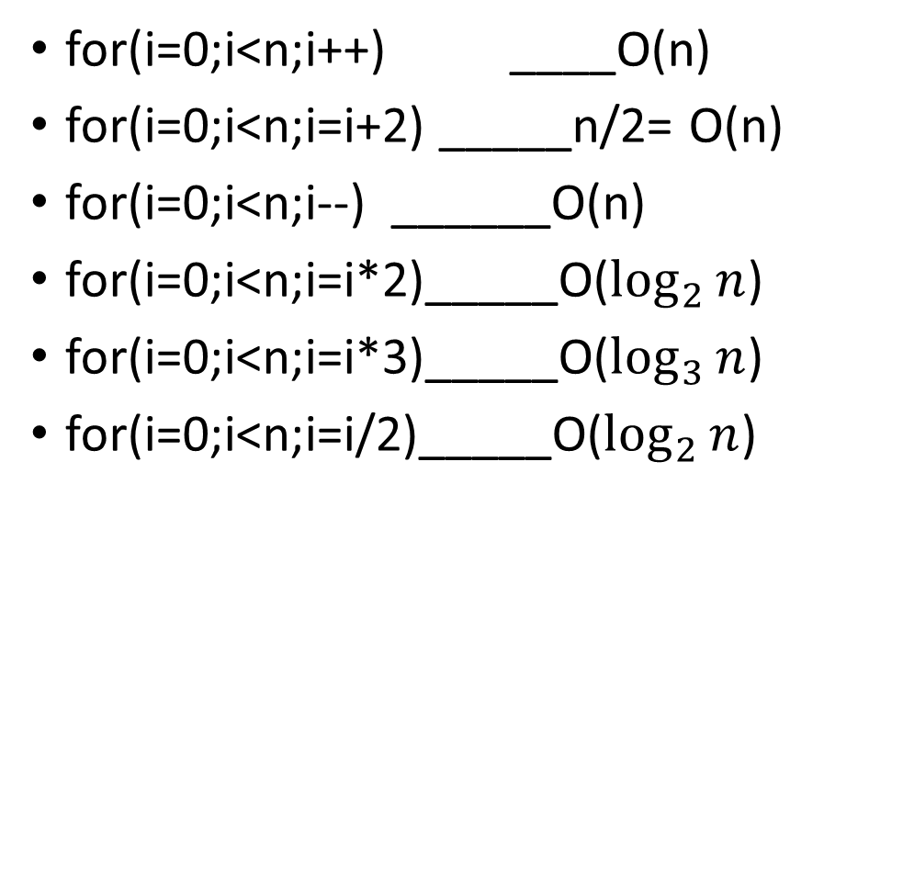
Time complexity
Ex: for(i=0;i<n;i++) ______ n+1
{
For(j=1;j<n;j=j*2) ______n * log n
{
statement; ________n*log n
}
}
Time complexity = 2n logn + n+1 = O(n)
for(i=0;i<n;i++) ____O(n)
for(i=0;i<n;i=i+2) _____n/2= O(n)
for(i=0;i<n;i--) ______O(n)
for(i=0;i<n;i=i*2)_____O($\log_{2}{n}$)
for(i=0;i<n;i=i*3)_____O($\log_{3}{n}$)
for(i=0;i<n;i=i/2)_____O($\log_{2}{n}$)

Slide 40

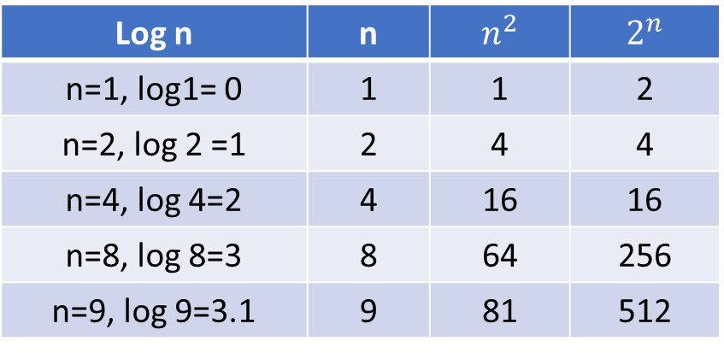
Types of Time function
O (1) = constant O (log n) = Logarthemic O ( n ) = Linear
O ($n^{2})=Quadratic$O ($n^{3}$) = Cubic
O($2^{n}$) = Exponential , O($3^{n}$) = Exponential, O($4^{n}$) = Exponential …….
O($n^{n}$) = Exponential
1 < log n < $\sqrt{n}$ < n < n log n < $n^{2}$ < $n^{3}$ …….< $2^{n}$ < $3^{n}$ < ……..< $n^{n}$
Log n | n | $n^{2}$ | $2^{n}$
n=1, log1= 0 | 1 | 1 | 2
n=2, log 2 =1 | 2 | 4 | 4
n=4, log 4=2 | 4 | 16 | 16
n=8, log 8=3 | 8 | 64 | 256
n=9, log 9=3.1 | 9 | 81 | 512

Slide 41
Asymptotic notations
Asymptotic notations are used to express time complexities of algorithms in worst, best and average cases. The following are different types of asymptotic notations which are used.
Big – Oh Notation ( Upper bound)
Big Omega Notation ( lower bound)
Theta Notation (Average bound)
Small Oh Notation
Small Omega Notation

Slide 42
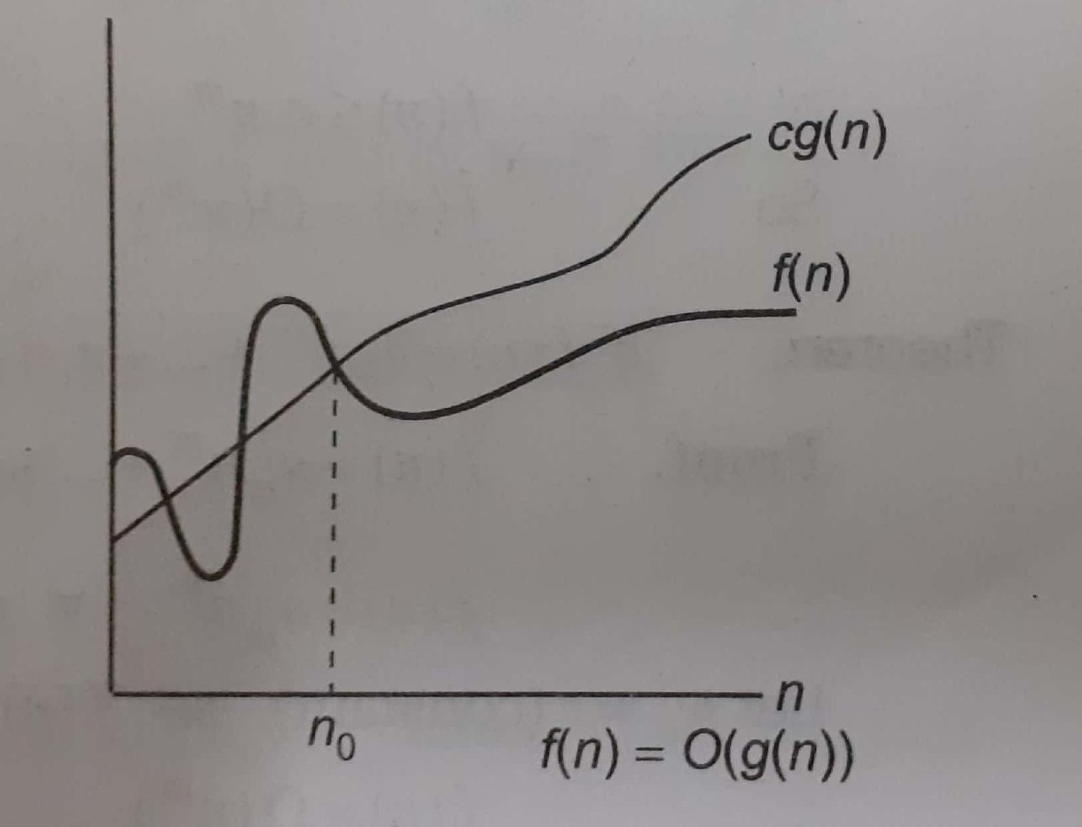
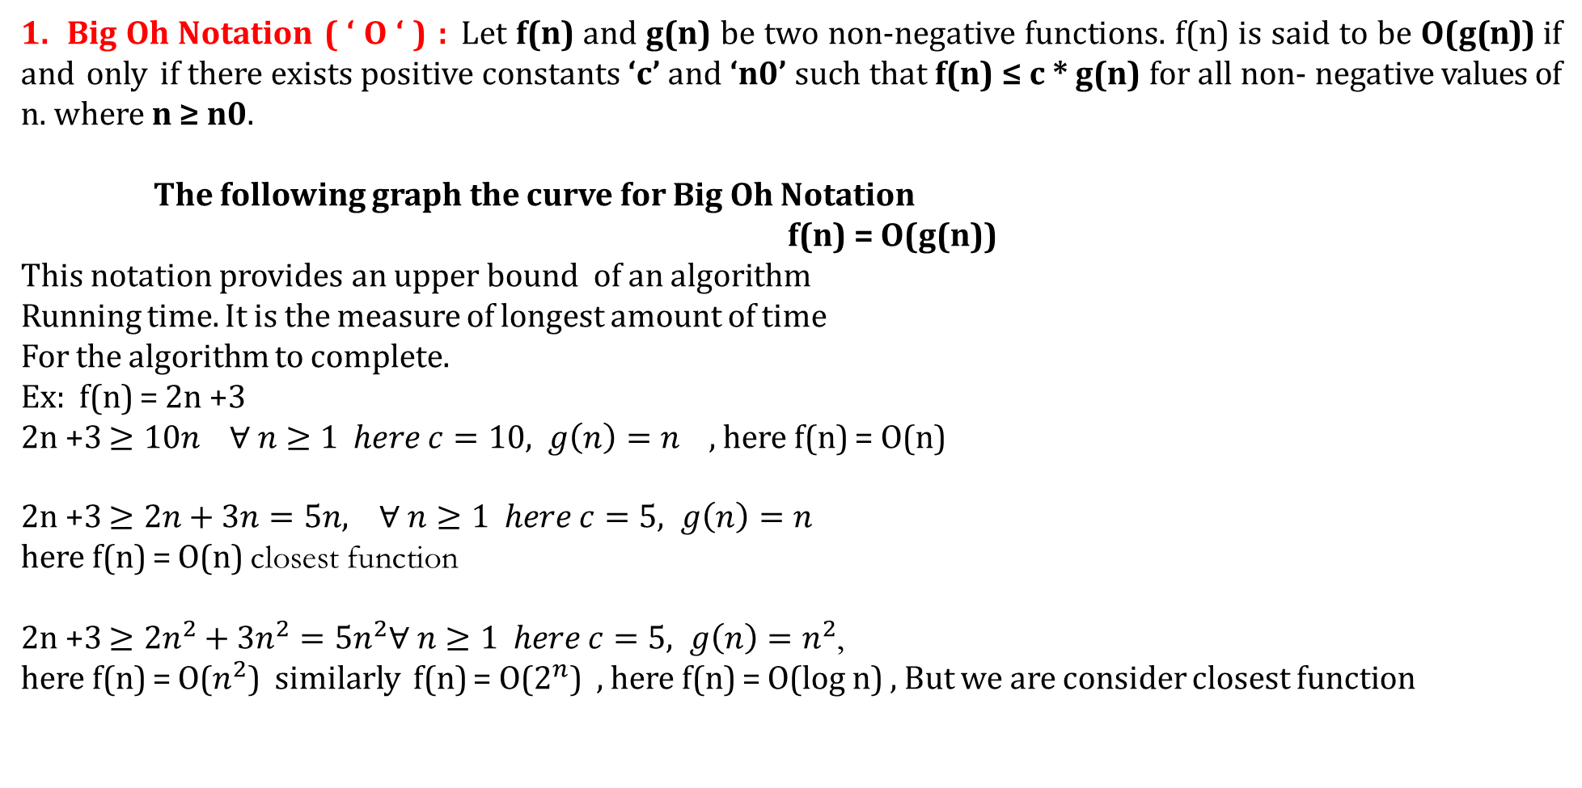
ASYMPTOTIC NOTATIONS
1. Big Oh Notation ( ‘ O ‘ ) : Let f(n) and g(n) be two non-negative functions. f(n) is said to be O(g(n)) if and only if there exists positive constants ‘c’ and ‘n0’ such that f(n) ≤ c * g(n) for all non- negative values of n. where n ≥ n0.
The following graph the curve for Big Oh Notation
f(n) = O(g(n))
This notation provides an upper bound of an algorithm
Running time. It is the measure of longest amount of time
For the algorithm to complete.
Ex: f(n) = 2n +3
2n +3 $≥10n ∀ n≥1 here c=10, g\left(n\right)=n$ , here f(n) = O(n)
2n +3 $≥2n+3n=5n, ∀ n≥1 here c=5, g\left(n\right)=n$
here f(n) = O(n) closest function
2n +3 $≥{2n}^{2}+{3n}^{2}={5n}^{2}∀ n≥1 here c=5, g\left(n\right)=n^{2}$,
here f(n) = O($n^{2}$) similarly f(n) = O($2^{n}$) , here f(n) = O(log n) , But we are consider closest function

Slide 43
Big Oh Notation
Compute Big-Oh notation for
f(n) = 3n+2
Ans: Given f(n) = 3n+2
f(n) ≤ c * g(n)
3n+2 ≤ 3n + n for n ≥ 2
3n+2 ≤ 4n where c = 4, g(n) = n and n₀=2
Hence f(n) = O(n)
b)Compute Big-Oh notation for
f(n) = 10n²+4n+2
Ans: Given f(n)= 10n²+4n+2
f(n) ≤ c * g(n)
10n²+4n+2 ≤ 10n²+4n+n for n ≥ 2
10n²+4n+2 ≤ 10n²+5n
10n²+4n+2 ≤ 10n²+n² for n ≥5
10n²+4n+2 ≤ 11n² where c = 11, g(n) = n² and n₀=5
Hence f(n) = O(n²)

Slide 44
Big Oh Notation
C )Compute Big-Oh notation for
f(n) = 1000n²+100n-6
Ans: Given f(n) = 1000n²+100n-6
f(n) ≤ c * g(n)
1000n²+100n-6 ≤ 1000 n²+100n for all values of n
1000n²+100n - 6 ≤ 1000 n²+n² for n ≥ 100
1000n²+100n - 6 ≤ 1001 n²
where c = 1001, g(n) = n² and n₀ = 100
Hence f(n)=O(n²)
D ) Compute Big-Oh notation for f(n) = 6*2^{n}+n²
Ans: Given f(n) = 6*2^{n}+n²
f(n) ≤ c * g(n)
6*2^{n}+n² ≤ 6*2^{n}+ 2^{n} for n ≥ 4
6*2^{n}+n² ≤ 7*2^{n} where c = 7, g(n)=2^{n}
and n₀=4
Hence f(n)=O(2^{n})

Slide 45
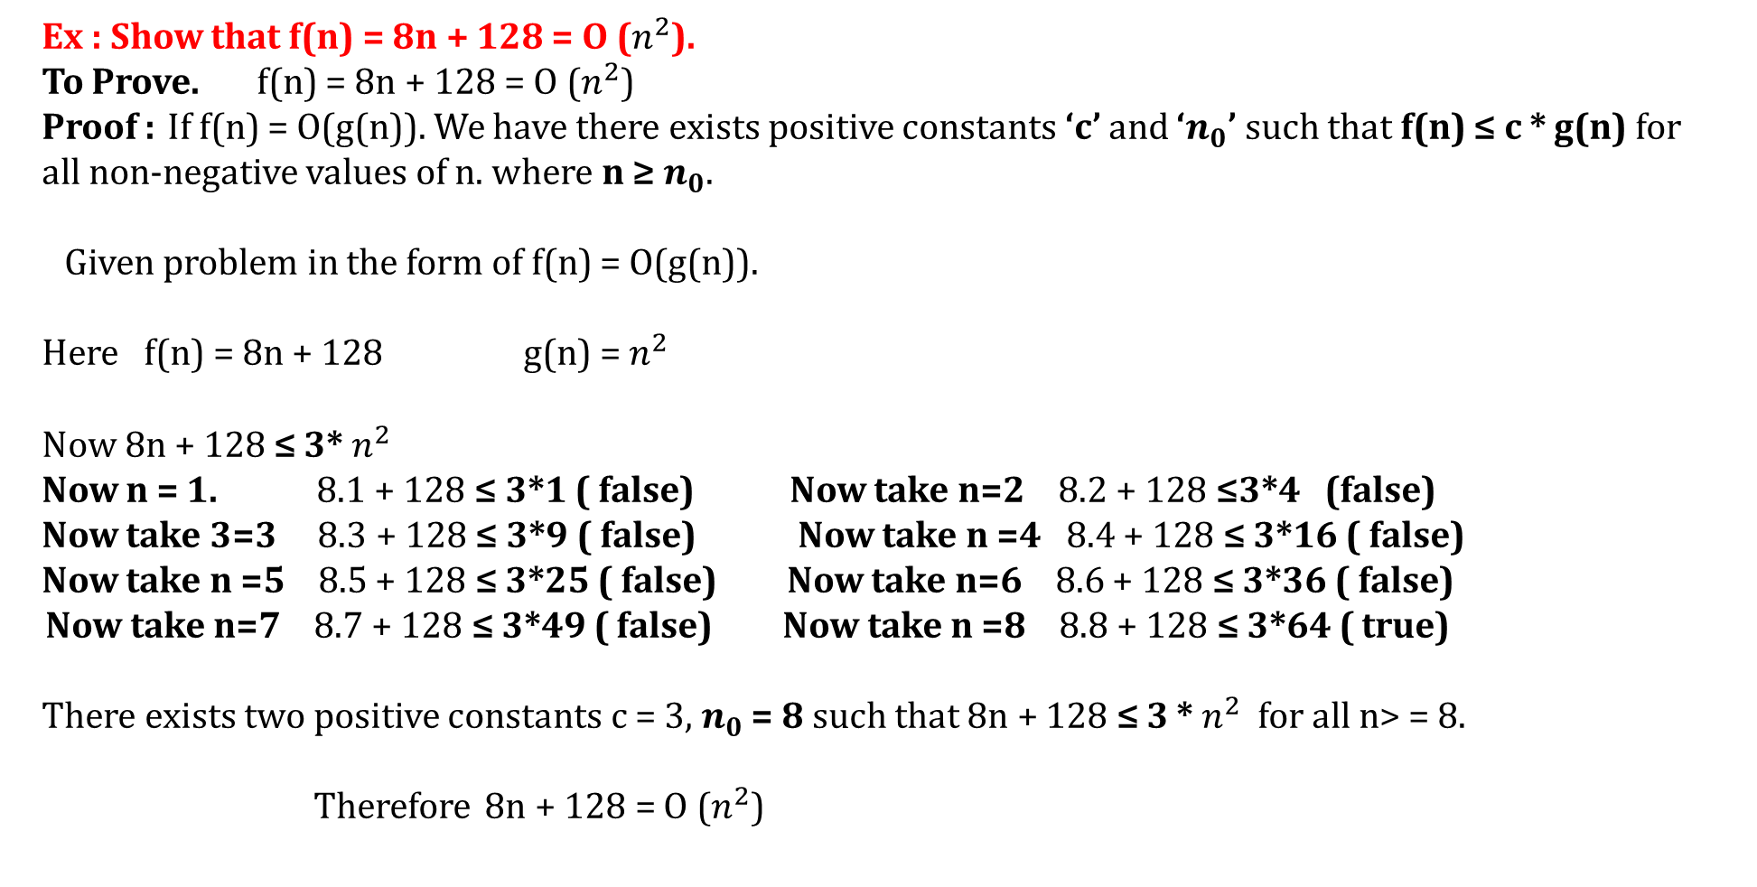
Big Oh Notation ( ‘ O ‘ )
Ex : Show that f(n) = 8n + 128 = O ($n^{2}$).
To Prove. f(n) = 8n + 128 = O ($n^{2}$)
Proof : If f(n) = O(g(n)). We have there exists positive constants ‘c’ and ‘$n_{0}$’ such that f(n) ≤ c * g(n) for all non-negative values of n. where n ≥ $n_{0}$.
Given problem in the form of f(n) = O(g(n)).
Here f(n) = 8n + 128 g(n) = $n^{2}$
Now 8n + 128 ≤ 3* $n^{2}$
Now n = 1. 8.1 + 128 ≤ 3*1 ( false) Now take n=2 8.2 + 128 ≤3*4 (false)
Now take 3=3 8.3 + 128 ≤ 3*9 ( false) Now take n =4 8.4 + 128 ≤ 3*16 ( false)
Now take n =5 8.5 + 128 ≤ 3*25 ( false) Now take n=6 8.6 + 128 ≤ 3*36 ( false)
Now take n=7 8.7 + 128 ≤ 3*49 ( false) Now take n =8 8.8 + 128 ≤ 3*64 ( true)
There exists two positive constants c = 3, $n_{0}$ = 8 such that 8n + 128 ≤ 3 * $n^{2}$ for all n> = 8.
Therefore 8n + 128 = O ($n^{2}$)

Slide 46
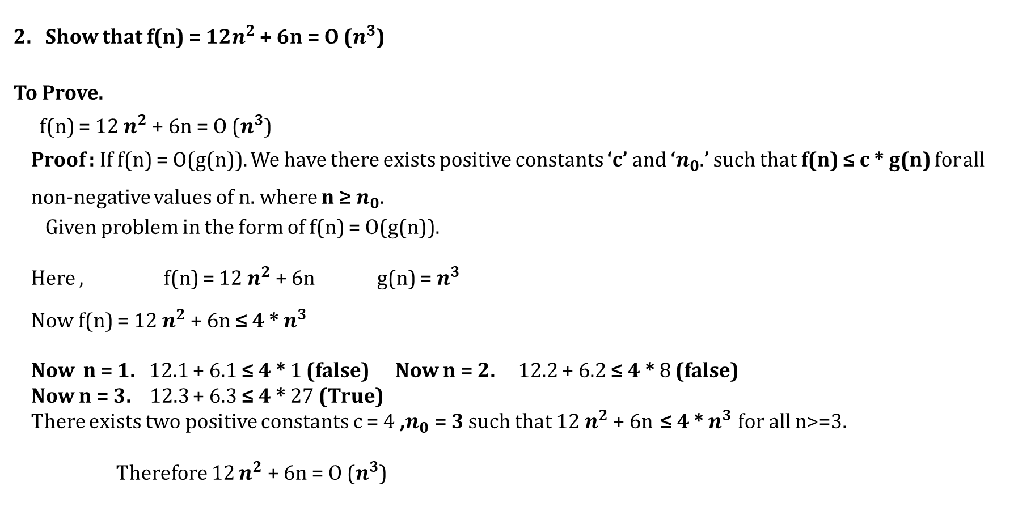
Big Oh Notation ( ‘ O ‘ )
Show that f(n) = 12$n^{2}$ + 6n = O ($n^{3}$)
To Prove.
f(n) = 12 $n^{2}$ + 6n = O ($n^{3}$)
Proof : If f(n) = O(g(n)). We have there exists positive constants ‘c’ and ‘$n_{0}$.’ such that f(n) ≤ c * g(n) for all non-negative values of n. where n ≥ $n_{0}$.
Given problem in the form of f(n) = O(g(n)).
Here , f(n) = 12 $n^{2}$ + 6n g(n) = $n^{3}$
Now f(n) = 12 $n^{2}$ + 6n ≤ 4 * $n^{3}$
Now n = 1. 12.1 + 6.1 ≤ 4 * 1 (false) Now n = 2. 12.2 + 6.2 ≤ 4 * 8 (false)
Now n = 3. 12.3 + 6.3 ≤ 4 * 27 (True)
There exists two positive constants c = 4 ,$n_{0}$= 3 such that 12 $n^{2}$ + 6n ≤ 4 * $n^{3}$ for all n>=3.
Therefore 12 $n^{2}$ + 6n = O ($n^{3}$)

Slide 47
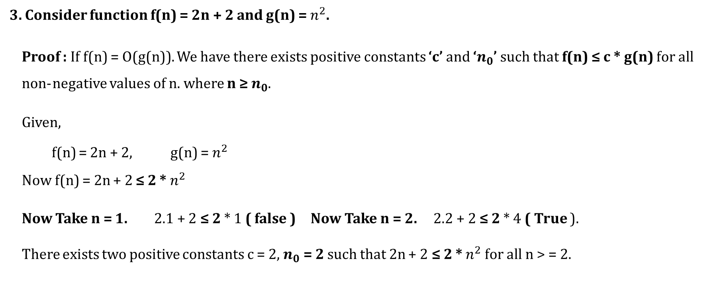
Big Oh Notation ( ‘ O ‘ )
3. Consider function f(n) = 2n + 2 and g(n) = $n^{2}$.
Proof : If f(n) = O(g(n)). We have there exists positive constants ‘c’ and ‘$n_{0}$’ such that f(n) ≤ c * g(n) for all non- negative values of n. where n ≥ $n_{0}$.
Given,
f(n) = 2n + 2, g(n) = $n^{2}$
Now f(n) = 2n + 2 ≤ 2 * $n^{2}$
Now Take n = 1. 2.1 + 2 ≤ 2 * 1 ( false ) Now Take n = 2. 2.2 + 2 ≤ 2 * 4 ( True ).
There exists two positive constants c = 2, $n_{0}$= 2 such that 2n + 2 ≤ 2 * $n^{2}$for all n > = 2.

Slide 48
Big Oh Notation ( ‘ O ‘ )
c) Compute Big-Oh notation for f(n) = 1000n²+100n-6
Ans: Given f(n) = 1000n² + 100n - 6
f(n) ≤ c * g(n)
1000n²+ 100n -6 ≤ 1000 n² + 100n for all values of n
1000n²+ 100n - 6 ≤ 1000 n² + n² for n ≥ 100
1000n²+100n-6 ≤ 1001 n² where c =1001, g(n) = n² and n₀=100
Hence f(n)=O(n²)

Slide 49
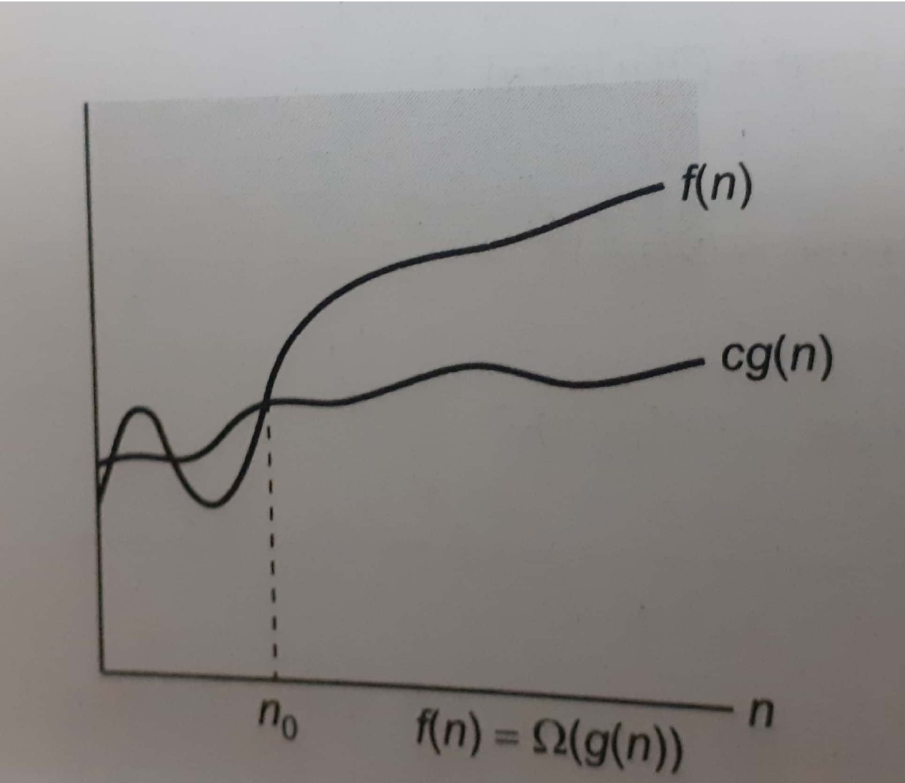
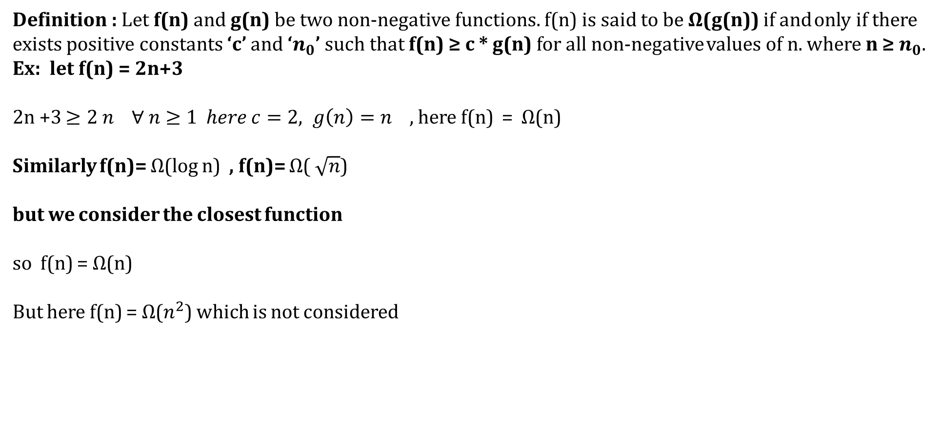
Omega Notation ( Ω ) :
Definition : Let f(n) and g(n) be two non-negative functions. f(n) is said to be Ω(g(n)) if and only if there
exists positive constants ‘c’ and ‘$n_{0}$’ such that f(n) ≥ c * g(n) for all non-negative values of n. where n ≥ $n_{0}$.
Ex: let f(n) = 2n+3
2n +3 $≥2 n ∀ n≥1 here c=2, g\left(n\right)=n$ , here f(n) = $Ω$(n)
Similarly f(n)= $Ω$(log n) , f(n)= $Ω$( $\sqrt{n}$)
but we consider the closest function
so f(n) = $Ω$(n)
But here f(n) = $Ω$($n^{2}$) which is not considered

Slide 50
Omega Notation ( Ω )
Compute omega notation for f(n)=3n+2
Ans: Given f(n)=3n+2
f(n) ≥ c * g(n)
3n+2≥3n for all values of n (n≥0)
Where c =3, g(n)=n and n₀=0
Hence f(n) = Ω(n)
b) Compute omega notation for f(n)= 10n²+4n+2
Ans: Given f(n)= 10n²+4n+2
f(n) ≥ c * g(n)
10n²+4n+2 ≥ 10n² for all values of n (n≥0)
Where c=10, g(n)=n² and n₀=0
Hence f(n) = Ω(n²)
Compute omega notation for f(n)= 4n³+2n+3
Ans: Given f(n)= 4n³ + 2n + 3
f(n) ≥ c * g(n)
4n³+2n+3 ≥ 4n³ for all values of n (n≥0)
Where c = 4, g(n) = n³ and n₀ = 0

Slide 51
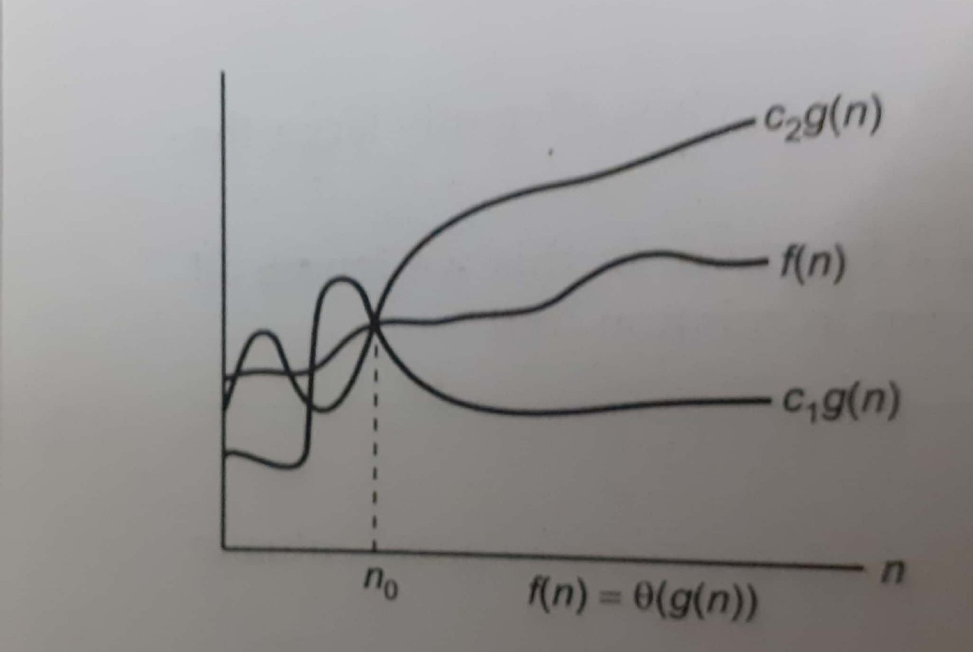
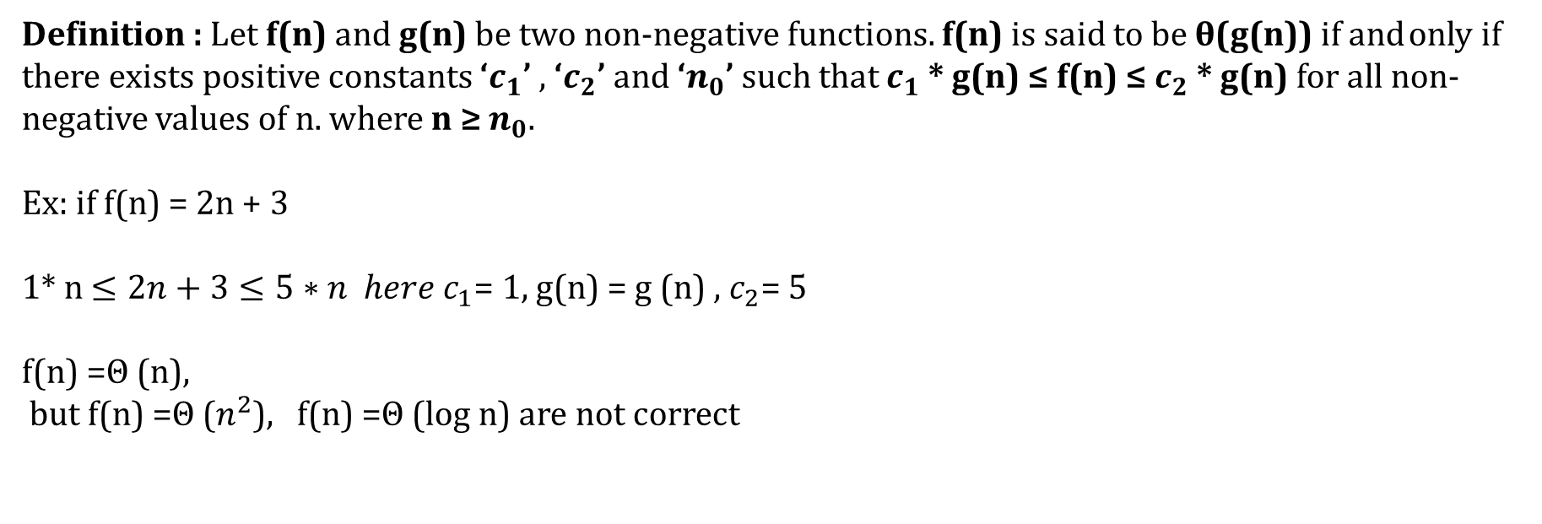
Theta Notation ( θ )
Definition : Let f(n) and g(n) be two non-negative functions. f(n) is said to be θ(g(n)) if and only if there exists positive constants ‘$c_{1}$’ , ‘$c_{2}$’ and ‘$n_{0}$’ such that $c_{1}$* g(n) ≤ f(n) ≤ $c_{2}$ * g(n) for all non-negative values of n. where n ≥ $n_{0}$.
Ex: if f(n) = 2n + 3
1* n $≤2n+3≤5∗n here c_{1}$= 1, g(n) = g (n) , $c_{2}$= 5
f(n) =Θ (n),
but f(n) =Θ ($n^{2}$), f(n) =Θ (log n) are not correct

Slide 52
Theta Notation
Compute theta notation for f(n)=3n+2
Ans: Given f(n)=3n+2
c₁* g(n) ≤ f(n) ≤ c₂*g(n)
Compute f(n) ≤ c₂*g(n)
3n + 2 ≤ 3n+n for n≥2
3n+2 ≤ 4n where c₂=2 and g(n)=n
Compute c₁* g(n) ≤ f(n)
3n ≤ 3n+2 for all values of n
Where c₁=3, g(n)=n
Hence f(n)= ө(n)
b) Compute theta notation for f(n) = 10n²+ 4n + 2
Ans: Given f(n) =10n² + 4n + 2
c₁* g(n) ≤ f(n) ≤ c₂*g(n)
Compute f(n) ≤ c₂*g(n)
10n²+4n+2 ≤ 10n² + 4n + n for n≥2
10n²+4n+2 ≤ 10n² + 5n
10n²+4n+2 ≤ 10n² + n² for n≥5
10n²+4n+2 ≤ 11n² where c₂=11 and g(n) = n²
Compute c₁* g(n) ≤ f(n)
10n² ≤ 10n² + 4n + 2 for all values of n
Where c₁ =10, g(n)=n²
Hence f(n) = ө(n²)

Slide 53
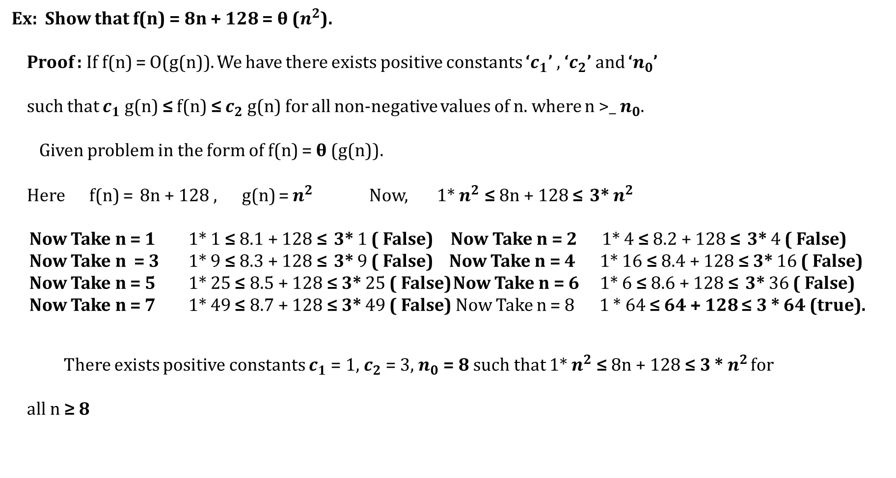
Theta Notation
Ex: Show that f(n) = 8n + 128 = θ ($n^{2}$).
Proof : If f(n) = O(g(n)). We have there exists positive constants ‘$c_{1}$’ , ‘$c_{2}$’ and ‘$n_{0}$’
such that $c_{1}$g(n) ≤ f(n) ≤ $c_{2}$g(n) for all non-negative values of n. where n >_ $n_{0}$.
Given problem in the form of f(n) = θ (g(n)).
Here f(n) = 8n + 128 , g(n) = $n^{2}$ Now, 1* $n^{2}$ ≤ 8n + 128 ≤ 3* $n^{2}$
Now Take n = 1 1* 1 ≤ 8.1 + 128 ≤ 3* 1 ( False) Now Take n = 2 1* 4 ≤ 8.2 + 128 ≤ 3* 4 ( False)
Now Take n = 3 1* 9 ≤ 8.3 + 128 ≤ 3* 9 ( False) Now Take n = 4 1* 16 ≤ 8.4 + 128 ≤ 3* 16 ( False) Now Take n = 5 1* 25 ≤ 8.5 + 128 ≤ 3* 25 ( False) Now Take n = 6 1* 6 ≤ 8.6 + 128 ≤ 3* 36 ( False) Now Take n = 7 1* 49 ≤ 8.7 + 128 ≤ 3* 49 ( False) Now Take n = 8 1 * 64 ≤ 64 + 128 ≤ 3 * 64 (true).
There exists positive constants $c_{1}$ = 1, $c_{2}$ = 3, $n_{0}$= 8 such that 1* $n^{2}$ ≤ 8n + 128 ≤ 3 * $n^{2}$ for all n ≥ 8

Slide 54

Little Oh Notation
Def : The Little Oh Notation is denoted by ‘ o ‘. The function f(n) = o(g(n)) iff $\lim_{n→∞}{\frac{f(n)}{g(n)}}$ = 0
Examples:
Compute theta notation for f(n)=3n+2
Let g(n) = 1, Then $\lim_{n→∞}{\frac{f(n)}{g(n)}}$ = ∞
Let g(n) = n, Then $\lim_{n→∞}{\frac{f(n)}{g(n)}}$ = 3
Let g(n) = $n^{2}$Then $\lim_{n→∞}{\frac{f(n)}{g(n)}}$ = 0
Hence f(n) = o(n²)

Slide 55
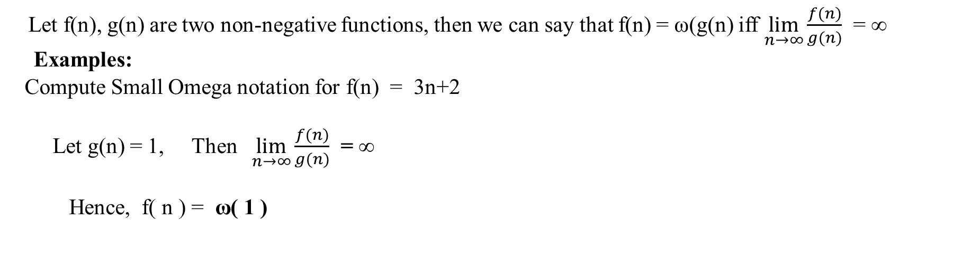
Small Omega Notation (ω)
Let f(n), g(n) are two non-negative functions, then we can say that f(n) = ω(g(n) iff $\lim_{n→∞}{\frac{f(n)}{g(n)}}$ = ∞
Examples:
Compute Small Omega notation for f(n) = 3n+2
Let g(n) = 1, Then $\lim_{n→∞}{\frac{f(n)}{g(n)}}$ = ∞
Hence, f( n ) = ω( 1 )

Slide 56
Average of Best Case, Worst Case, Average Case
Best Case : If the algorithm takes the minimum amount of time to run to completion for a specifi set
of inputs is called Best Case Time Complexity.
2. Worst Case : If the algorithm takes maximum amount of time to run to completion for a specific set of
inputs is called Worst Case Time Complexity.
3. Average Case : If the algorithm takes average amount of time to run to completion for a specific set of inputs is called Average Case.

